Slide 1
Fundamentals of Non-line-of-sight Imaging

Slide 2
Introduction to Non-line-of-sight Imaging
Back Projection for NLOS imaging
Signals and Systems
Light Cone Transform for NLOS imaging

Slide 3
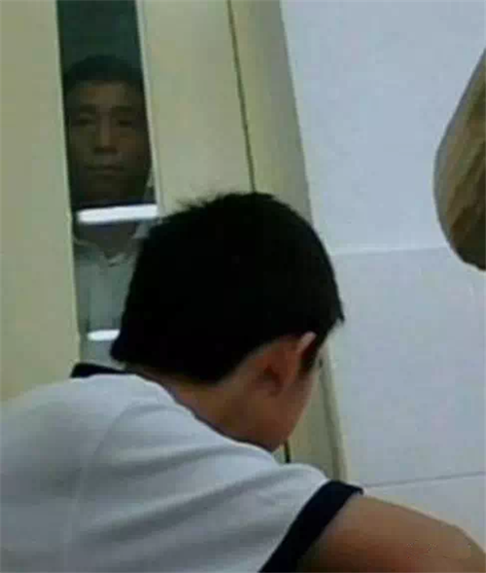
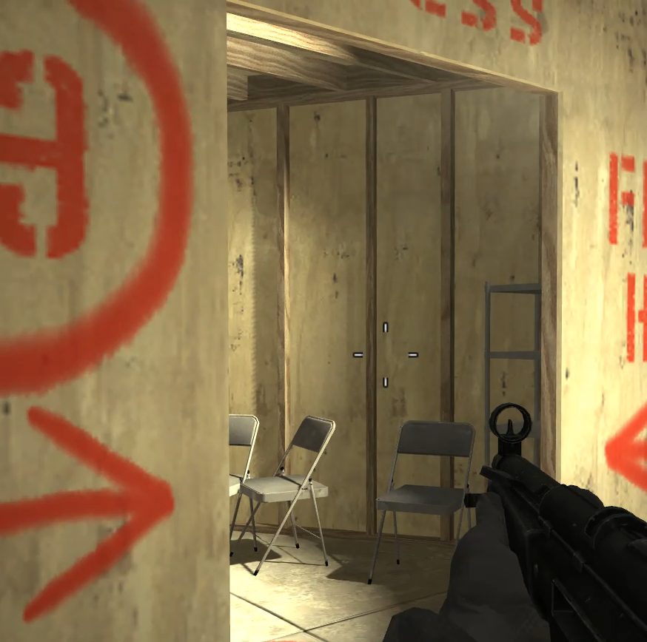
Some applications of NLOS

Slide 4
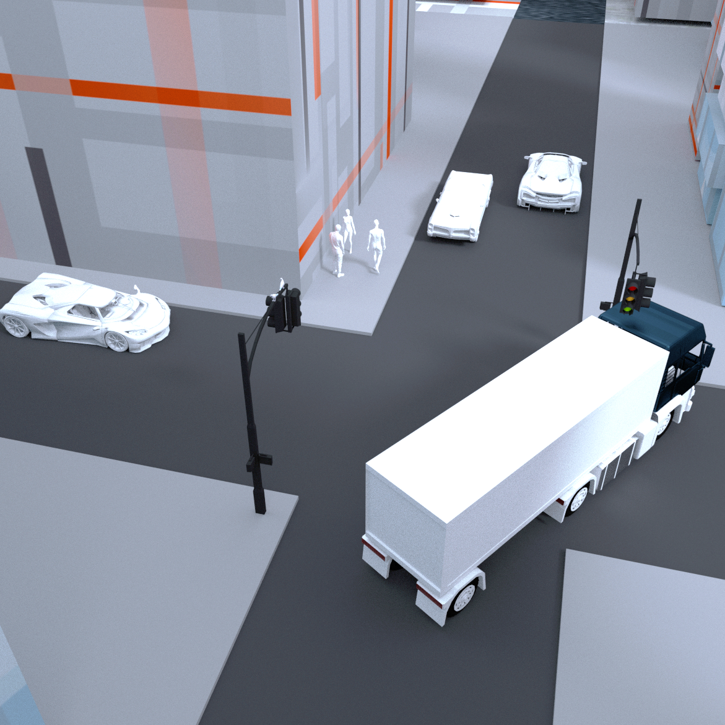
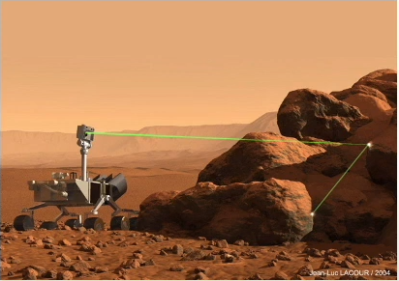
Some applications of NLOS
Self-driving
Remote Sensing

Slide 5
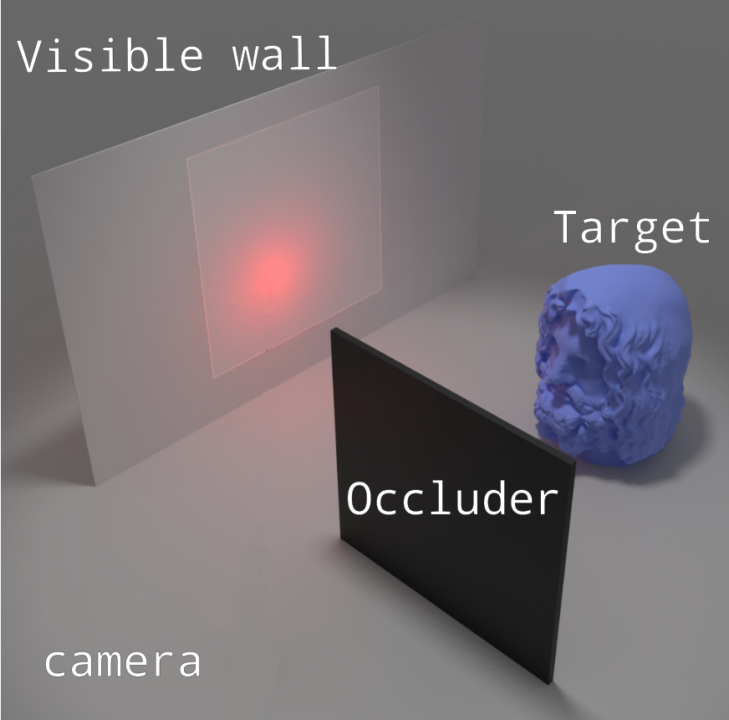
Why we can’t see directly from NLOS?
How does light of object enter the camera?
Visible wall: diffuse.
Camera looking at the visible wall.
Explanation from ray tracing
Each pixel have the similar response of object.
- Photometric stereo as example
How to solve the problem?
Diversity between pixels.
Each pixel had better have response from only one part from object.
Time of flight solution

Slide 6
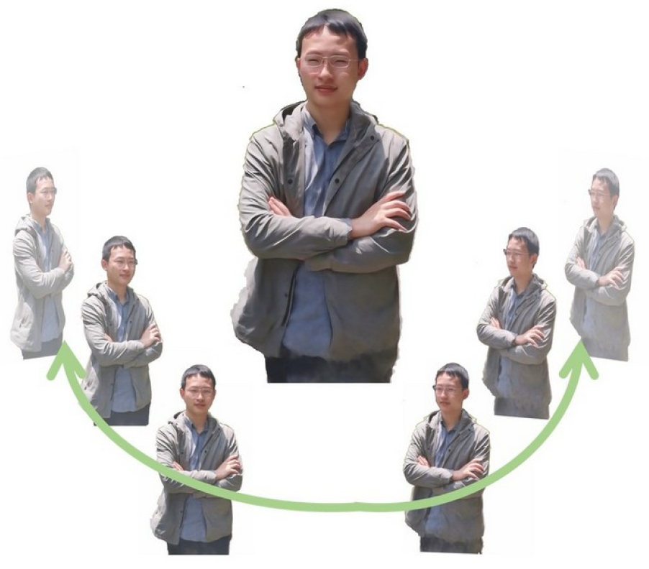
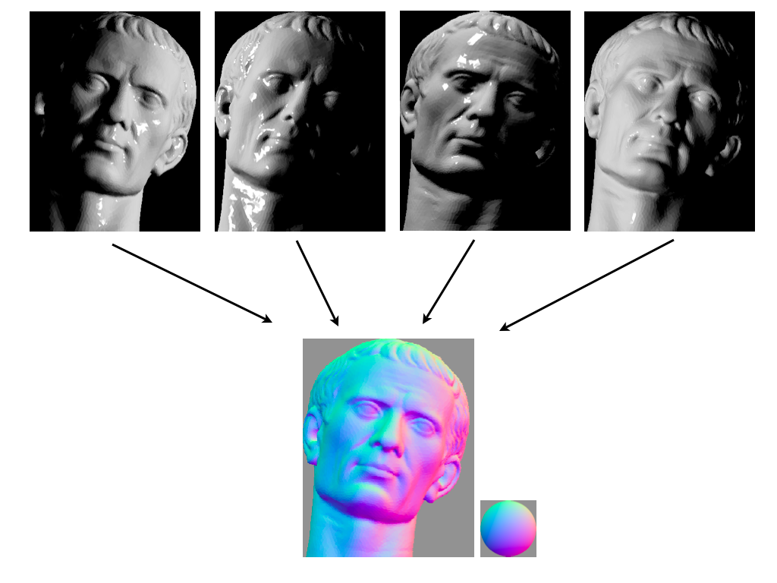
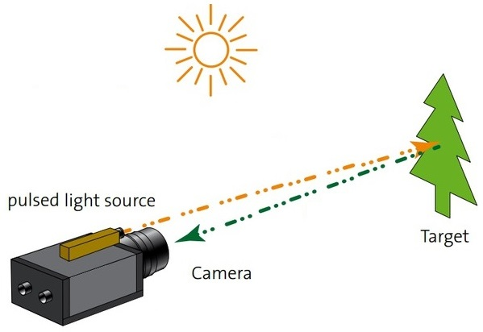
Los Imaging
How to acquire 3D information?
-MVS, photometric stereo, ToF(LiDAR, CW)
Streak camera

Slide 7
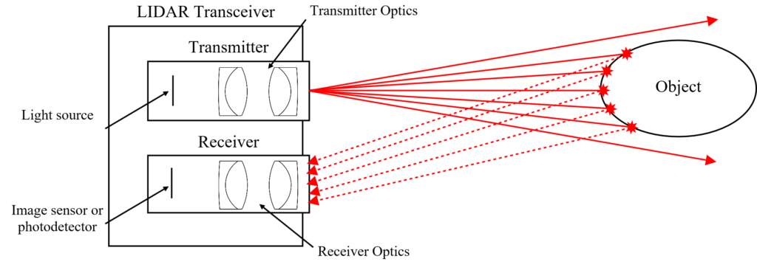
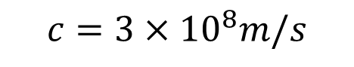
LIDAR
3m v.s. 100MHz
0.3m v.s. 1GHz
0.03m v.s. 10GHz
0.003m v.s. 100GHz
$$c=3×{10}^{8}m/s$$

Slide 8
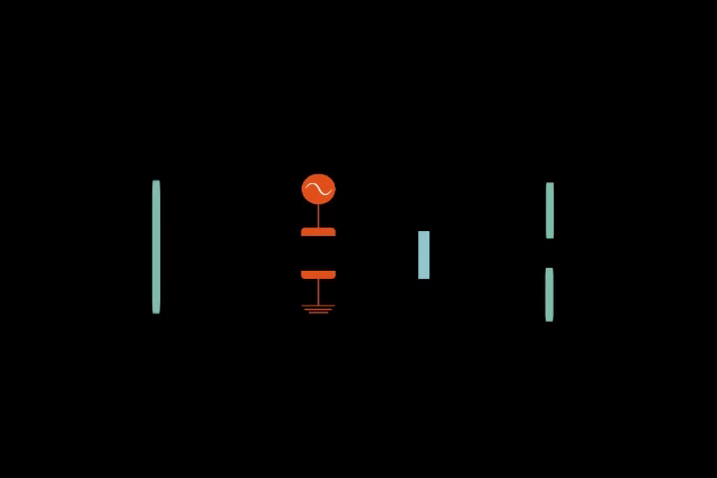
ToF imaging with Streak Camera
streak camera_2.mp4

Slide 9
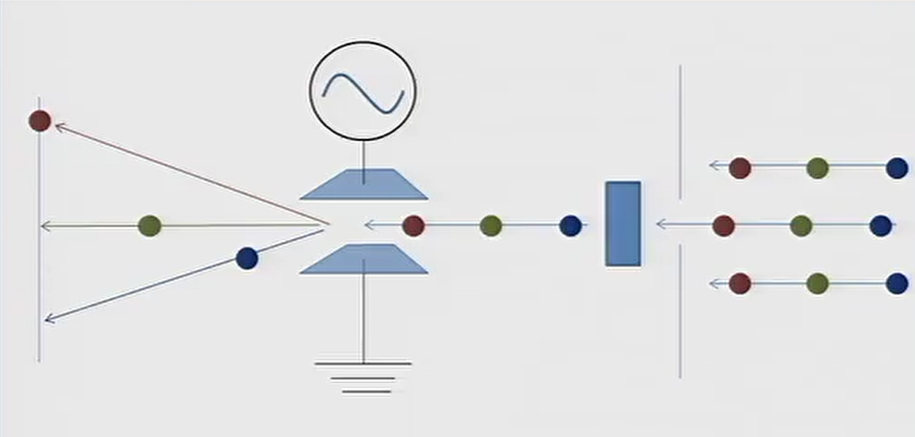
ToF imaging with Streak Camera

Slide 10
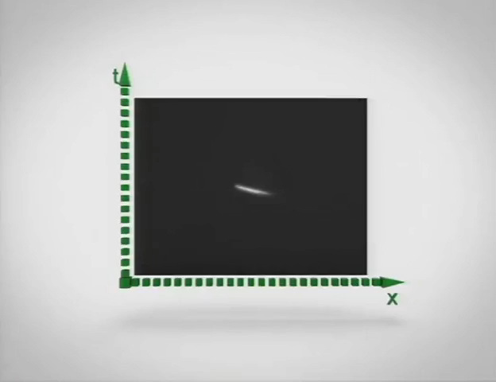
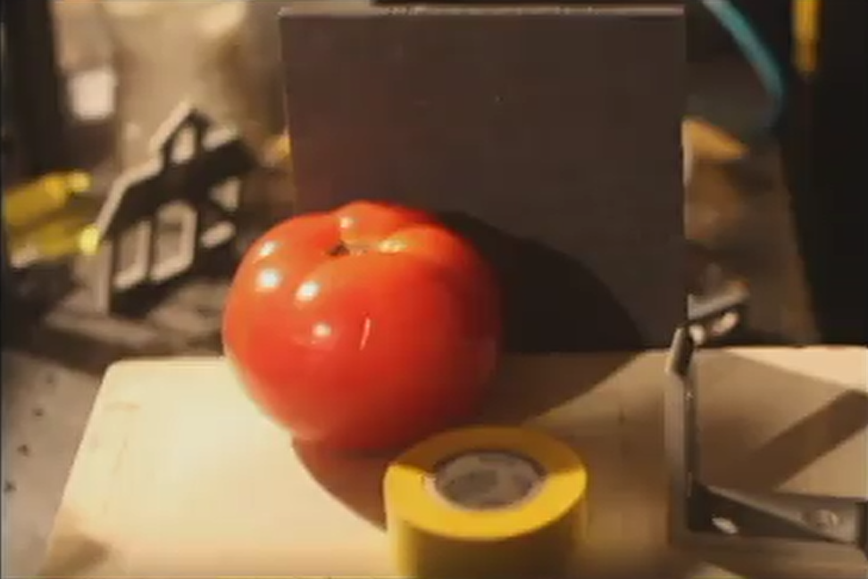
ToF imaging with Streak Camera
View direction
streak camera.mp4
Q&A

Slide 11
Back Projection for NLOS Imaging
Andreas Velten, Thomas Willwacher, Otkrist Gupta,
Ashok Veeraraghavan, Moungi G. Bawendi, Ramesh Raskar

Slide 12
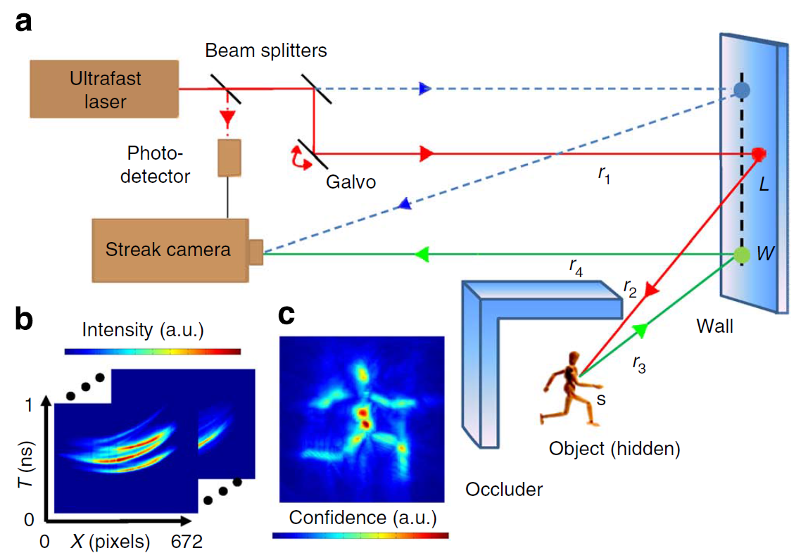
What does this paper do?
What is the measurement?
How to imaging from the measurement?

Slide 13
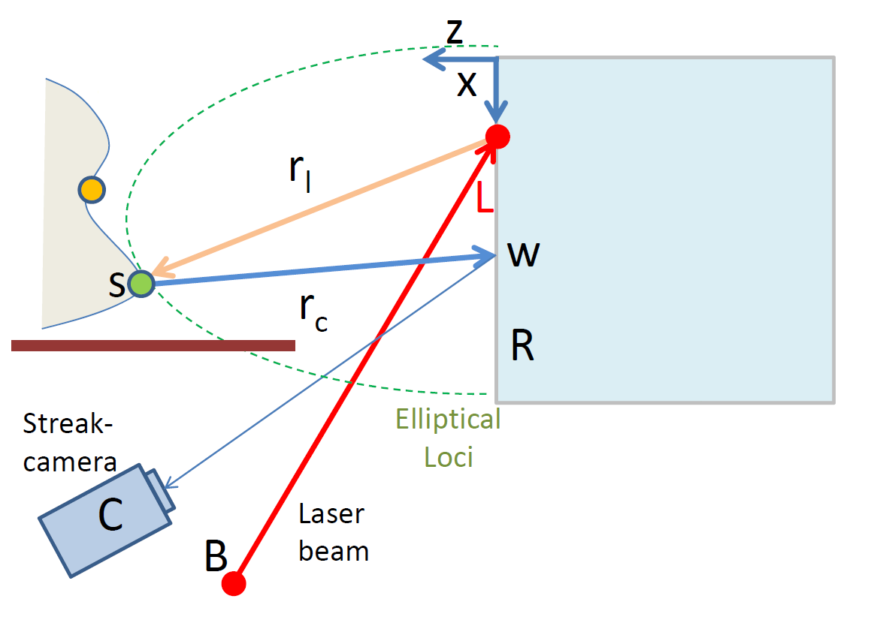
Imaging model

Slide 14
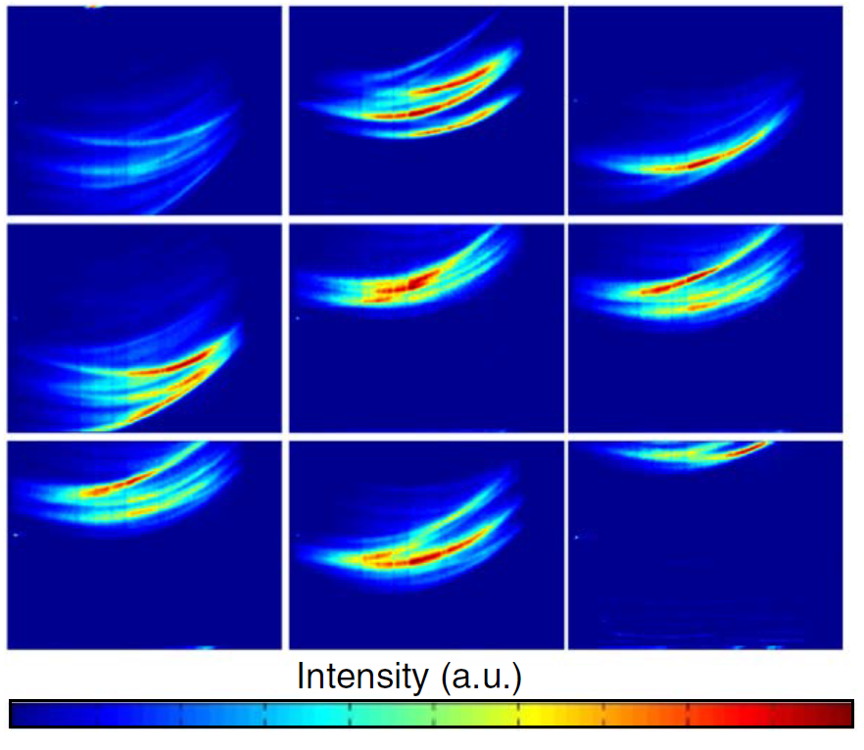
Imaging model
Each pixel tells us the object exists on the corresponding ellipsoid.
But we don’t know the location of the object on the ellipsoid.

Slide 15
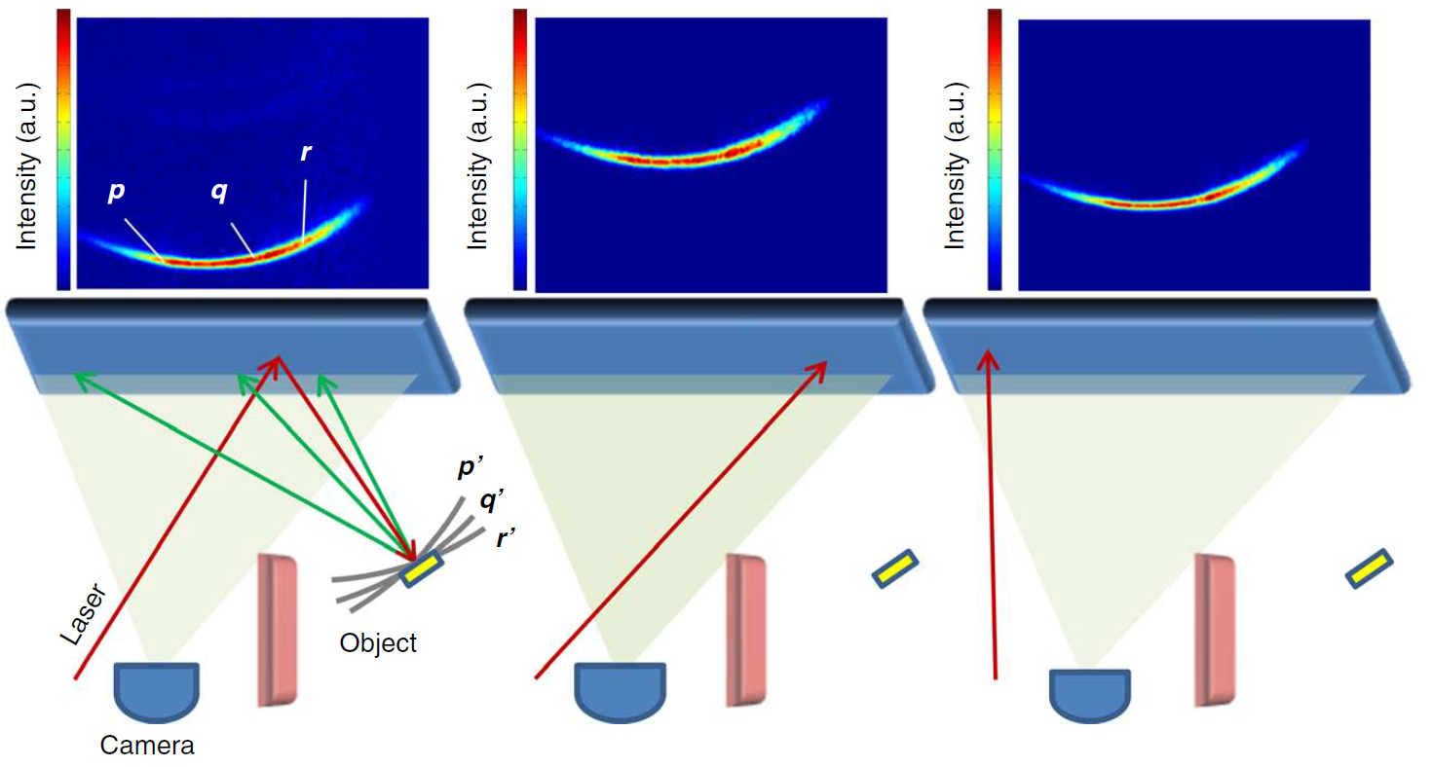
Back Projection

Slide 16
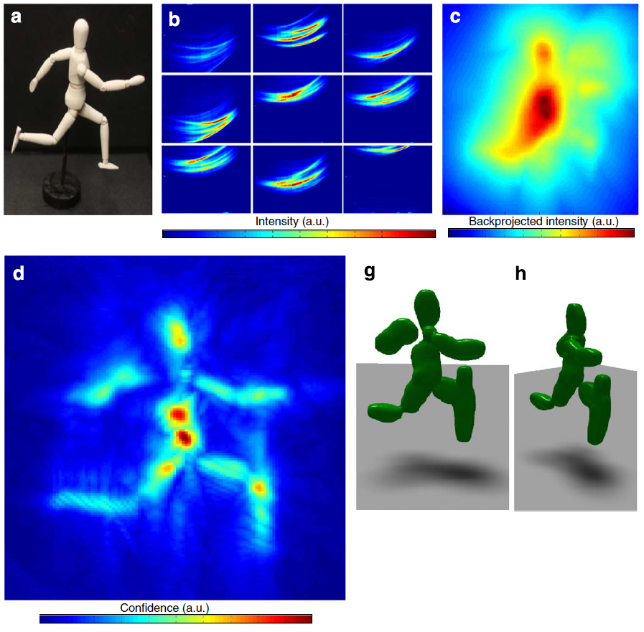
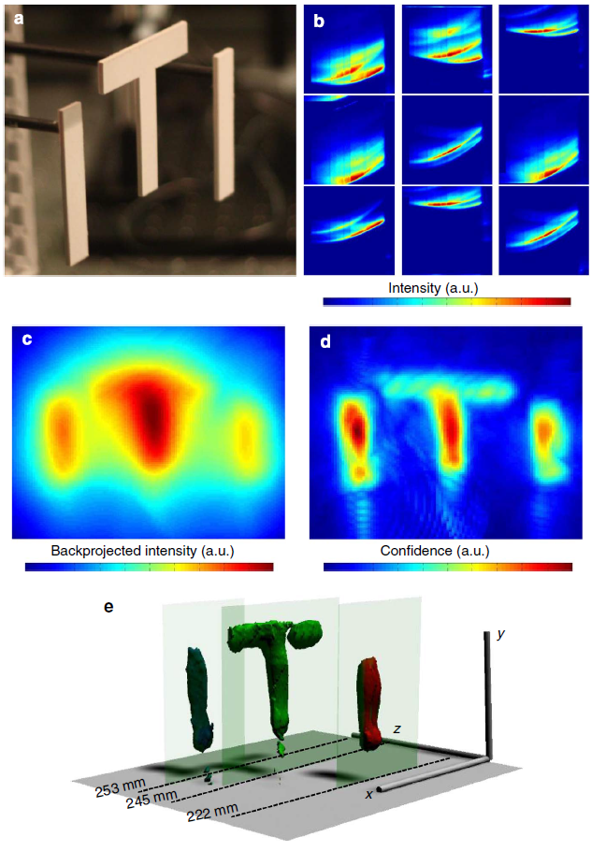
Results

Slide 17
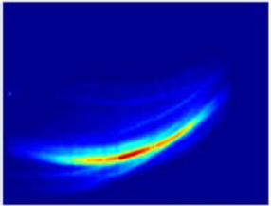
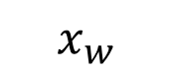

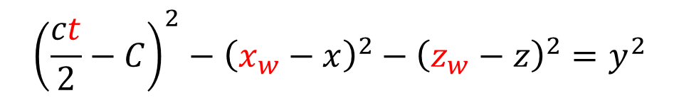
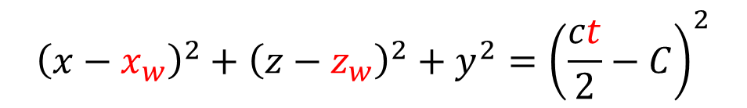
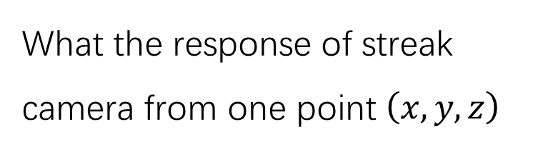
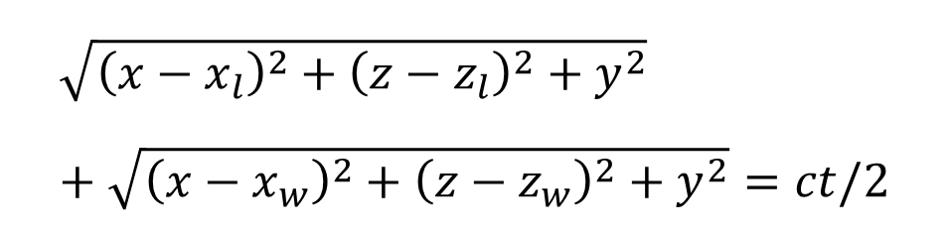

What the response of streak camera from one point $\left(x,y,z\right)$
More about Imaging Model
$$r_{l}+r_{c}=ct/2$$
$$\sqrt{{\left(x−x_{l}\right)}^{2}+{\left(z−z_{l}\right)}^{2}+y^{2}}+\sqrt{{\left(x−x_{w}\right)}^{2}+{\left(z−z_{w}\right)}^{2}+y^{2}}=ct/2$$
We want to know the relationship of $(x_{w},z_{w},t)$
$$C+\sqrt{{\left(x−x_{w}\right)}^{2}+{\left(z−z_{w}\right)}^{2}+y^{2}}=ct/2$$
$${\left(x−x_{w}\right)}^{2}+{\left(z−z_{w}\right)}^{2}+y^{2}={\left(\frac{ct}{2}−C\right)}^{2}$$
$${\left(\frac{ct}{2}−C\right)}^{2}−{\left(x_{w}−x\right)}^{2}−{\left(z_{w}−z\right)}^{2}=y^{2}$$
$$t$$
$$t^{2}−{x_{w}}^{2}−{z_{w}}^{2}=y^{2}$$
The unit response is hyperbola.
The measurement is combination of many hyperbola.
$$x_{w}$$

Slide 18
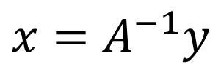
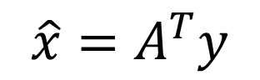

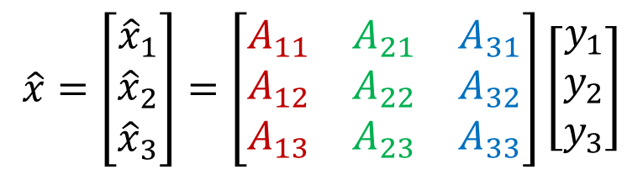
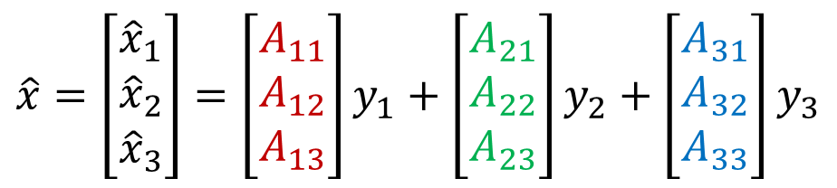
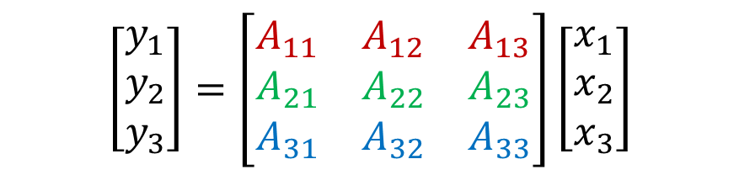
More about Back Projection
$$y=Ax$$
$$\left[\begin{matrix}y_{1} \\ y_{2} \\ y_{3}\end{matrix}\right]=\left[\begin{matrix}A_{11} & A_{12} & A_{13} \\ A_{21} & A_{22} & A_{23} \\ A_{31} & A_{32} & A_{33}\end{matrix}\right]\left[\begin{matrix}x_{1} \\ x_{2} \\ x_{3}\end{matrix}\right]$$
One ellipsoid: one row of A
$$\hat{x}=\left[\begin{matrix}{\hat{x}}_{1} \\ {\hat{x}}_{2} \\ {\hat{x}}_{3}\end{matrix}\right]=\left[\begin{matrix}A_{11} \\ A_{12} \\ A_{13}\end{matrix}\right]y_{1}+\left[\begin{matrix}A_{21} \\ A_{22} \\ A_{23}\end{matrix}\right]y_{2}+\left[\begin{matrix}A_{31} \\ A_{32} \\ A_{33}\end{matrix}\right]y_{3}$$
$$\hat{x}=\left[\begin{matrix}{\hat{x}}_{1} \\ {\hat{x}}_{2} \\ {\hat{x}}_{3}\end{matrix}\right]=\left[\begin{matrix}A_{11} & A_{21} & A_{31} \\ A_{12} & A_{22} & A_{32} \\ A_{13} & A_{23} & A_{33}\end{matrix}\right]\left[\begin{matrix}y_{1} \\ y_{2} \\ y_{3}\end{matrix}\right]$$
?
$$\hat{x}=A^{T}y$$
$$x=A^{−1}y$$

Slide 19
Video
Q & A

Slide 20




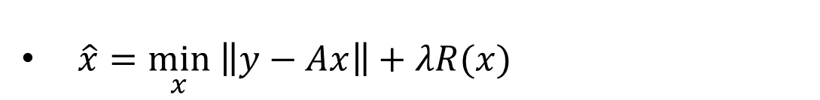
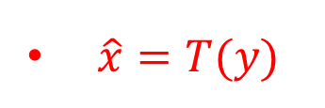

Inverse Problem
$$y=Ax$$
time
$\hat{x}=A^{−1}y or \hat{x}={\left(A^{T}A\right)}^{−1}A^{T}y$
1920s
$\hat{x}=A^{T}y$
$\hat{x}=T(y)$
1980s
$\hat{x}=\min_{x} \left\|y−Ax\right\|+λR(x)$
2000s
$\hat{x}=network(y)$
2010s
$\hat{x}=network(y,A^{T}y)$
2015s

Slide 21
Light Cone Transform in None-line-of-sight Imaging
——the application of signal and system

Slide 22
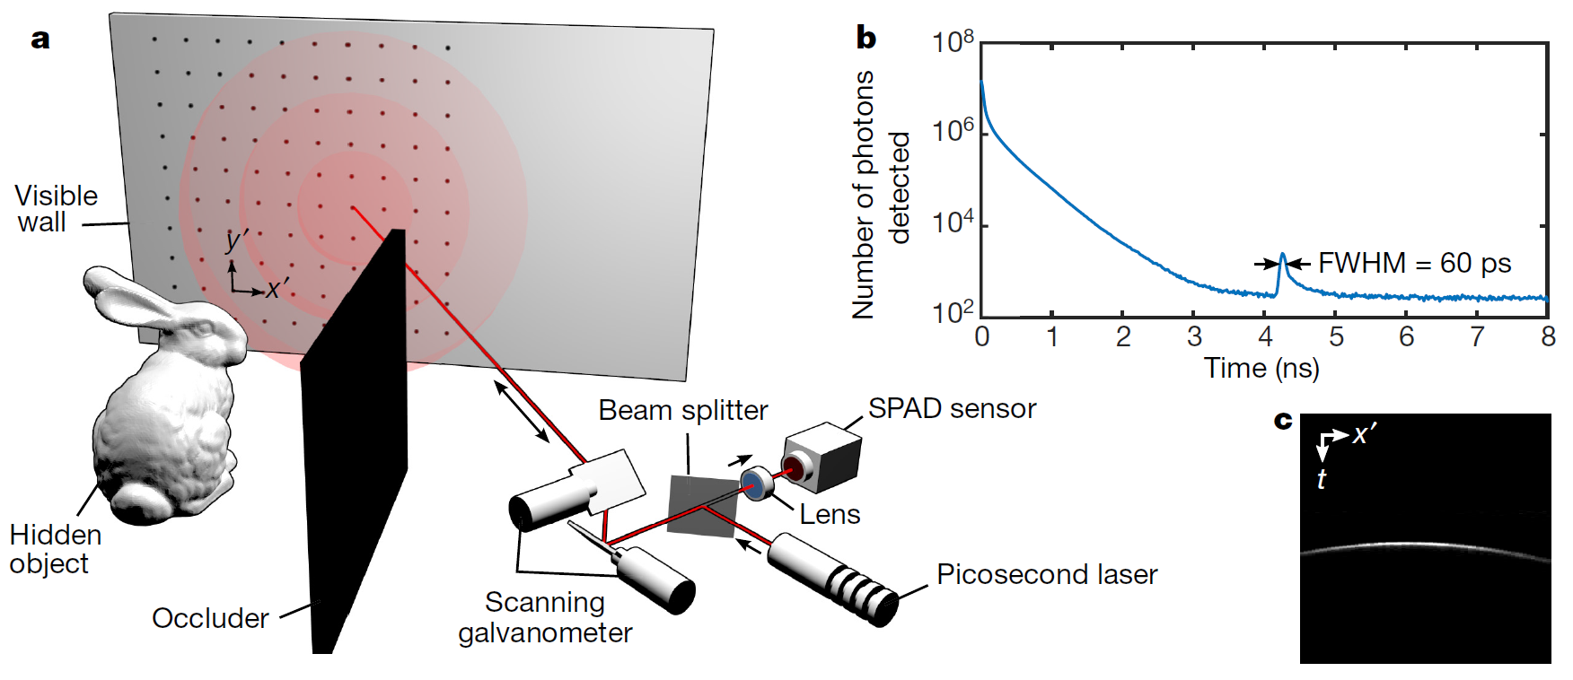
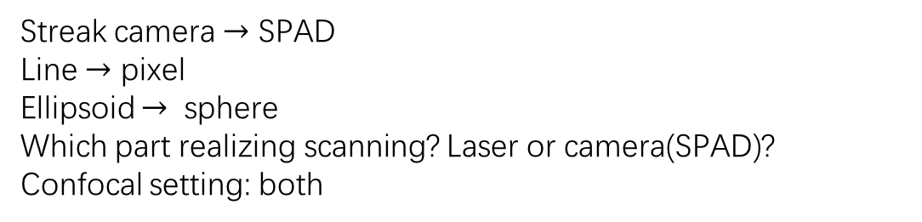
1.2m~1.5m, 0.15m
Streak camera $→$ SPAD
Line $→$ pixel
Ellipsoid $→$ sphere
Which part realizing scanning? Laser or camera(SPAD)?
Confocal setting: both
Benefits：
1.Compact system
2.Retroreflective material

Slide 23
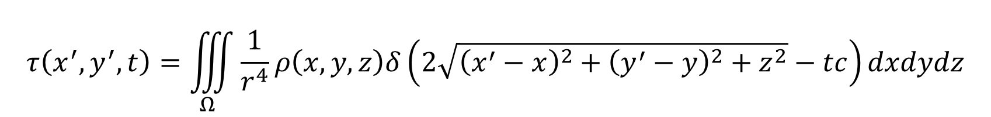
Laser and SPAD
$$τ\left(x^{′},y^{′},t\right)=\iiint_{Ω}{\frac{1}{r^{4}}ρ\left(x,y,z\right)δ\left(2\sqrt{{\left(x^{′}−x\right)}^{2}+{\left(y^{′}−y\right)}^{2}+z^{2}}−tc\right)dxdydz}$$

Slide 24
How to solve the NLOS problem by filtering methods?

Slide 25
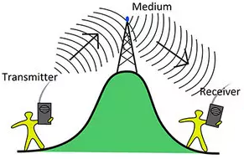
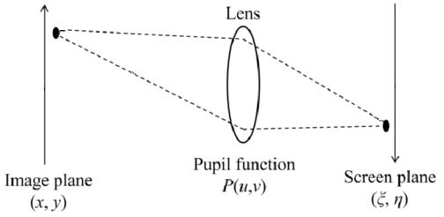
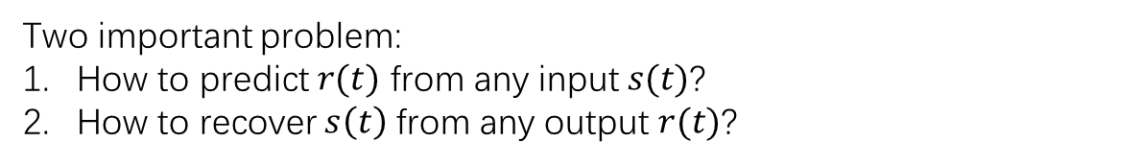
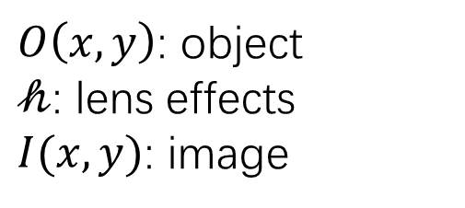
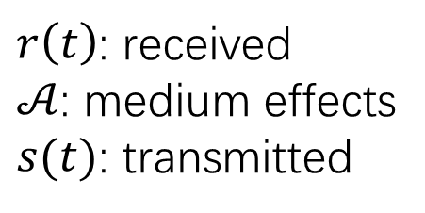

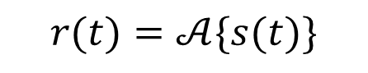
Fundamentals of Signal and System
Communication system
$r\left(t\right)$: received
$𝒜$: medium effects
$s(t)$: transmitted
2-D Imaging system
$O\left(x,y\right)$: object
$𝒽$: lens effects
$I(x,y)$: image
$$r(t)=𝒜\{s(t)\}$$
$$I\left(x,y\right)=𝒽\{O\left(x,y\right)\}$$
Eg
Two important problem:
How to predict $r(t)$ from any input $s(t)$?
How to recover $s\left(t\right)$ from any output $r(t)$?

Slide 26
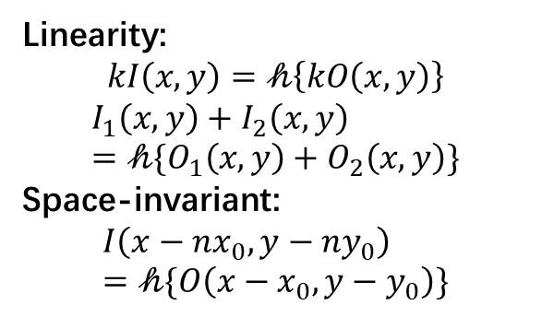
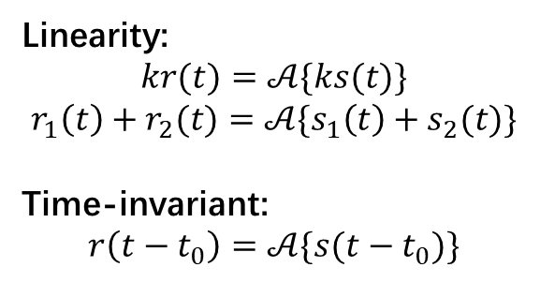

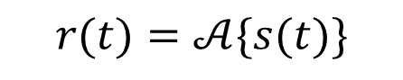
Fundamentals of Signal and System
Communication system
Linearity:
$$kr(t)=𝒜\{ks(t)\}$$
$$r_{1}\left(t\right)+r_{2}(t)=𝒜\{s_{1}\left(t\right)+s_{2}(t)\}$$
Time-invariant:
$$r\left(t−t_{0}\right)=𝒜\{s(t−t_{0})\}$$
Linearity:
$$kI\left(x,y\right)=𝒽\left\{kO\left(x,y\right)\right\}$$
$$I_{1}\left(x,y\right)+I_{2}\left(x,y\right)=𝒽\{O_{1}\left(x,y\right)+O_{2}\left(x,y\right)\}$$
Space-invariant:
$$I\left(x−nx_{0},y−ny_{0}\right)=𝒽\{O\left(x−x_{0},y−y_{0}\right)\}$$
2-D Imaging system
$$I\left(x,y\right)=𝒽\{O\left(x,y\right)\}$$
$$r(t)=𝒜\{s(t)\}$$
How to make use of properties of $𝒜$ and $𝒽$?

Slide 27
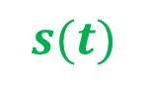

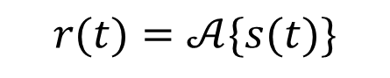
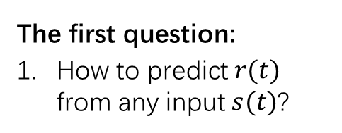
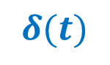

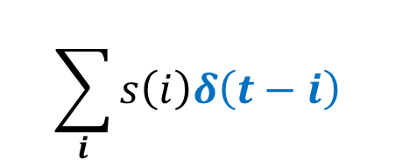












Fundamentals of Signal and System
$$r(t)=𝒜\{s(t)\}$$
Consider the LTI system $𝒜$
Linearity:
$$kr(t)=𝒜\{ks(t)\}$$
$$r_{1}\left(t\right)+r_{2}(t)=𝒜\{s_{1}\left(t\right)+s_{2}(t)\}$$
Time-invariant:
$$r\left(t−t_{0}\right)=𝒜\{s(t−t_{0})\}$$
$$𝒜$$
$$δ(t)$$
$$h(t)$$
analysis
synthesis
$$𝒜$$
$$s(t)$$
$$r(t)$$
$s\left(t\right)$ can be decomposed as linear combination of $δ\left(t\right)$
$$s\left(t\right)=s\left(0\right)δ\left(t−0\right)+s\left(1\right)δ\left(t−1\right)…+s\left(N\right)δ\left(t−N\right)=\sum_{i}{s\left(i\right)δ\left(t−i\right)}$$
And we can define unit impulse response:
$$h\left(t\right)=𝒜(δ(t))$$
The first question:
How to predict $r(t)$ from any input $s(t)$?
From linearity and invariancy we know that
$$𝒜$$
$$δ(t−i)$$
$$h\left(t−i\right)$$
Which is
$$r\left(t\right)=\sum_{i}{s\left(i\right)}h\left(t−i\right)$$
unit impulse response is able to describe the LTI system.
$$\sum_{i}{s\left(i\right)δ\left(t−i\right)}$$
$$𝒜$$
$$\sum_{i}{s\left(i\right)}h\left(t−i\right)$$

Slide 28

















Fundamentals of Signal and System
Consider another analysis and synthesis approach:
$$s\left(t\right)=\sum_{i}{S\left(i\right)W_{i}(t)}$$
$$𝒜$$
$$δ(t)$$
$$h(t)$$
analysis
synthesis
$$r\left(t\right)=\sum_{i}{R\left(i\right)W_{i}(t)}$$
$$𝒜$$
We hope that:
$s\left(t\right)$ and $S\left(i\right)$, $r\left(t\right)$ and $R\left(i\right)$ are inter-resolvable.
$S\left(i\right)$ and $R\left(i\right)$ are inter-resolvable.
$$s(t)$$
$$r(t)$$
$$s\left(t\right)=\sum_{i}{s\left(i\right)δ\left(t−i\right)}=δ\left(t\right)∗s(t)$$
According to the LTI system:
$$𝒜$$
$$W_{i}(t)$$
$$𝒜(W_{i}\left(t\right))$$
$$r\left(t\right)=\sum_{i}{s\left(i\right)}h\left(t−i\right)=h\left(t\right)∗s(t)$$
$$\sum_{i}{S\left(i\right)𝒜(W_{i}\left(t\right))}$$
$$\sum_{i}{S\left(i\right)W_{i}(t)}$$
$$𝒜$$
$$𝒜$$
Which is defined as convolution
$$s\left(t\right)$$
$$r\left(t\right)$$
$$r\left(t\right)=\sum_{i}{S\left(i\right)𝒜(W_{i}\left(t\right))}$$
The second question:
2. How to recover $s\left(t\right)$ from any output $r(t)$?

Slide 29
















Fundamentals of Signal and System
$$r\left(t\right)=\sum_{i}{R\left(i\right)W_{i}(t)}=\sum_{i}{S\left(i\right)λ_{i}W_{i}(t)}$$
$$𝒜$$
$$W_{i}(t)$$
$$𝒜 (W_{i}\left(t\right))$$
analysis
synthesis
$$𝒜$$
So we have $R\left(i\right)=S\left(i\right)λ_{i}$
$$s(t)$$
$$r(t)$$
The second question:
2. How to recover $s\left(t\right)$ from any output $r(t)$?
$$r\left(t\right)=\sum_{i}{S\left(i\right)𝒜(W_{i}\left(t\right))}$$
From LTI system
Step 1: compute $R\left(i\right)$ from $r\left(t\right)$ and $W_{i}\left(t\right)$
Step 2: compute $S\left(i\right)$ from $R\left(i\right)$ and $λ_{i}$.
Step 3: compute $s(t)$ from $S\left(i\right)$ and $W_{i}(t)$.
$$r\left(t\right)=\sum_{i}{R\left(i\right)W_{i}(t)}$$
From definition
(so we need irrelevant basis.)
We want $S\left(i\right)$ and $R\left(i\right)$ are inter-resolvable. Consider the eigenvector of $𝒜$, which is $W_{i}\left(t\right)$, as basis of analysis and synthesis
Necessary condition :
$W_{i}\left(t\right)$ and $λ_{i}$ are known
$s\left(t\right)$ and $S\left(i\right)$, $r\left(t\right)$ and $R\left(i\right)$ are inter-resolvable.
How?
$$𝒜\left(W_{i}\left(t\right)\right)=λ_{i}W_{i}(t)$$
$W_{i}\left(t\right)$ is the eigenvector of $𝒜$, $λ_{i}$ is the corresponding eigenvalue.

Slide 30













Fundamentals of Signal and System
Thm $e^{jwt}$ is eigen-function of LTI system $𝒜$.
$$𝒜$$
$$e^{jwt}$$
$$H(w)e^{jwt}$$
?
The second question:
2. How to recover $s\left(t\right)$ from any output $r(t)$?
$$𝒜$$
$$e^{jwt}$$
$$h\left(t\right)∗e^{jwt}$$
$$=\sum_{i}{h\left(i\right)e^{jw(t−i)}}$$
Step 1: compute $R\left(i\right)$ from $r\left(t\right)$ and $W_{i}\left(t\right)$
Step 2: compute $S\left(i\right)$ from $R\left(i\right)$ and $λ_{i}=H\left(w\right)$.
Step 3: compute $s(t)$ from $S\left(i\right)$ and $W_{i}(t)$.
$$=e^{jwt}\sum_{i}{h\left(i\right)e^{−jwi}}$$
Necessary condition :
$W_{i}\left(t\right)$ and $λ_{i}$ are known
$s\left(t\right)$ and $S\left(i\right)$, $r\left(t\right)$ and $R\left(i\right)$ are inter-resolvable.
$$=e^{jwt}H(w)$$
The eigen value is
$$H\left(w\right)=\sum_{i}{h\left(i\right)e^{−jwi}}$$
How?

Slide 31








Fundamentals of Signal and System
$$S\left(i\right)=\frac{1}{T}\int_{−T/2}^{T/2}{s\left(t\right)}e^{jiw_{0}t}dt$$
$$𝒜$$
$$e^{jwt}$$
$$H(w)$$
analysis
synthesis
$$R\left(i\right)=\frac{1}{T}\int_{−T/2}^{T/2}{r\left(t\right)}e^{jiw_{0}t}dt$$
$$𝒜$$
$$s(t)$$
$$r(t)$$
$$s\left(t\right)=\sum_{i}{S\left(i\right)e^{jw_{i}t}}$$
Convergence condition of Fourier series:
Periodic function
Continuous or finite incontinuous points.
Finite local minimum.
Converge to $(f\left(x_{+}\right)+f(x_{−}))/2$
$$r\left(t\right)=\sum_{i}{R\left(i\right)e^{jw_{i}t}}$$

Slide 32









Fundamentals of Signal and System
Continuous form: Fourier transform
$$𝒜$$
$\hat{s}\left(t\right)$ is non-periodic function with infinite period $T$
$$e^{jwt}$$
$$H(w)$$
analysis
synthesis
$$S\left(i\right)=\frac{1}{T}\int_{−∞}^{∞}{\hat{s}\left(t\right)}e^{−jiw_{0}t}dt$$
$$𝒜$$
$$s(t)$$
$$r(t)$$
$$s\left(t\right)=\sum_{i}{S\left(i\right)e^{jw_{i}t}}$$
$$s\left(t\right)=\sum_{i}{S\left(i\right)e^{jw_{i}t}}$$
$$s\left(t\right)=\sum_{i}{\frac{1}{T}e^{jw_{i}t}\int_{−∞}^{∞}{\hat{s}\left(τ\right)}e^{−jiw_{0}τ}dτ}$$
$$r\left(t\right)=\sum_{i}{R\left(i\right)e^{jw_{i}t}}$$
$$S\left(i\right)=\frac{1}{T}\int_{−T/2}^{T/2}{s\left(t\right)}e^{−jiw_{0}t}dt$$
$$s\left(t\right)=\sum_{i}{\frac{1}{T}e^{jw_{i}t}S(iw_{0})}$$
$$\lim_{\begin{aligned}T→∞, \\ w_{0}→0\end{aligned}} s\left(t\right)=\sum_{i}{\frac{w_{0}}{2π}e^{jw_{i}t}S(iw_{0})}=\frac{1}{2π}\int{e^{jwt}S\left(w\right)dw}$$
$$R\left(i\right)=\frac{1}{T}\int_{−T/2}^{T/2}{r\left(t\right)}e^{−jiw_{0}t}dt$$

Slide 33












Fundamentals of Signal and System
$$𝒜$$
The second question:
2. How to recover $s\left(t\right)$ from any output $r(t)$?
$$e^{jwt}$$
$$H(w)$$
analysis
synthesis
$$𝒜$$
Step 1: compute $R\left(w\right)$ from $r\left(t\right)$ by Fourier transform.
Step 2: compute $S\left(w\right)$ from $H(w)$ by convolution theorem.
Step 3: compute $s(t)$ from $S\left(w\right)$ by inverse Fourier transform.
$$s(t)$$
$$r(t)$$
$$s\left(t\right)=\sum_{i}{S\left(i\right)e^{jw_{i}t}}$$
$$s\left(t\right)=\int{S\left(w\right)e^{jwt}dw}$$
$$r\left(t\right)=\sum_{i}{R\left(i\right)e^{jw_{i}t}}$$
$$r\left(t\right)=\int{R\left(w\right)e^{jwt}dw}$$
$$R\left(i\right)=S\left(i\right)λ_{i}$$
$$R\left(w\right)=S\left(w\right)H(w)$$
(convolution theorem)
$$S\left(i\right)=\frac{1}{T}\int_{0}^{T}{s\left(t\right)}e^{jiw_{0}t}dt$$
$$S\left(w\right)=\int{s\left(t\right)}e^{−jwt}dt$$
$$R\left(i\right)=\frac{1}{T}\int_{0}^{T}{r\left(t\right)}e^{jiw_{0}t}dt$$
$$R\left(w\right)=\int{r\left(t\right)}e^{−jwt}dt$$

Slide 34










Fundamentals of Signal and System
LTI system $𝓐$
$$𝒜$$
$$𝒜$$
$$δ(t)$$
$$h(t)$$
$$e^{jwt}$$
$$H(w)$$
analysis
synthesis
analysis
synthesis
$$𝒜$$
$$𝒜$$
$$s(t)$$
$$r(t)$$
$$s(t)$$
$$r(t)$$
How to recover $s(t)$from any output$r\left(t\right)$?
How to predict $r\left(t\right)$from any input $s(t)$?
$$R\left(w\right)=\int{r\left(t\right)}e^{−jwt}dt$$
$$r\left(t\right)=h\left(t\right)∗s(t)$$
$$S\left(w\right)=\frac{R\left(w\right)}{H(w)}$$
unit impulse response is able to describe the LTI system.
(inverse filtering)
$$s\left(t\right)=\int{S\left(w\right)e^{jwt}dw}$$

Slide 35








Fundamentals of Signal and System
Linear System:
1. The matrix of LTI system is circular matrix:
$$r=As$$
$$r∈R^{M},s∈R^{N}, A∈R^{M×N}$$
$$A=\left[\begin{matrix}a_{11} & & \\ a_{21} & a_{11} & \\ a_{31} & a_{21} & a_{11}\end{matrix}\right]$$
$$\left[\begin{matrix}r_{1} \\ r_{2} \\ r_{3}\end{matrix}\right]=\left[\begin{matrix}a_{11} & a_{12} & a_{13} \\ a_{21} & a_{22} & a_{23} \\ a_{31} & a_{32} & a_{33}\end{matrix}\right]\left[\begin{matrix}s_{1} \\ s_{2} \\ s_{3}\end{matrix}\right]$$
Convolution:
2. How to check a system is LTI?
$$r=h∗s$$
Check if $h$ is time-invariant
$$r=s_{1}h_{\left(i−1\right)}+s_{2}h_{(i−2)}+s_{3}h_{(i−3)}$$
Compare two Eqs. and We have:
$$h_{\left(i−1\right)}=\left[\begin{matrix}a_{11} \\ a_{21} \\ a_{31}\end{matrix}\right],h_{\left(i−2\right)}=\left[\begin{matrix}a_{12} \\ a_{22} \\ a_{32}\end{matrix}\right],h_{\left(i−3\right)}=\left[\begin{matrix}a_{13} \\ a_{23} \\ a_{33}\end{matrix}\right]$$

Slide 36
Come back to NLOS imaging…

Slide 37


camera
$$τ\left(x^{′},y^{′},t\right)=\iiint_{Ω}{\frac{1}{r^{4}}ρ\left(x,y,z\right)δ\left(2\sqrt{{\left(x^{′}−x\right)}^{2}+{\left(y^{′}−y\right)}^{2}+z^{2}}−tc\right)dxdydz}$$
Syetem $𝒜$:
$$ρ\left(x,y,z\right)→τ(x^{′},y^{′},t)$$
Linear?
Invariant?

Slide 38









$$r=ct/2$$
$$\sqrt{{\left(x−x′\right)}^{2}+{\left(y−y′\right)}^{2}+z^{2}}=ct/2$$
$${\left(x−x′\right)}^{2}+{\left(y−y′\right)}^{2}+z^{2}={\left(\frac{ct}{2}\right)}^{2}$$
$${\left(\frac{ct}{2}\right)}^{2}−{\left(x′−x\right)}^{2}−{\left(y′−y\right)}^{2}=z^{2}$$
The curve of unit impulse response is hyperbola.
A necessary condition of invariant system::
Shift $ρ$ by $Δx,Δy,Δz$, does $τ$ also shift $Δx,Δy,Δz$?
camera
$${\left(\frac{ct}{2}\right)}^{2}−z^{2}={\left(x′−x\right)}^{2}+{\left(y′−y\right)}^{2}$$
$$τ\left(x^{′},y^{′},t\right)=\iiint_{Ω}{\frac{1}{r^{4}}ρ\left(x,y,z\right)}$$
$$δ\left(2\sqrt{{\left(x^{′}−x\right)}^{2}+{\left(y^{′}−y\right)}^{2}+z^{2}}−tc\right)dxdydz$$
$${\left(\frac{ct}{2}−\frac{cΔt}{2}\right)}^{2}−{\left(z−Δz\right)}^{2}={\left(\frac{ct}{2}\right)}^{2}−z^{2}$$
$$Δz=\frac{c^{2}}{4}Δt$$
Neglect second order part.
To some extent identity.

Slide 39




How to deal with $r^{4}$?
$$τ\left(x^{′},y^{′},t\right)=\iiint_{Ω}{\frac{1}{r^{4}}ρ\left(x,y,z\right)}δ\left(2\sqrt{{\left(x^{′}−x\right)}^{2}+{\left(y^{′}−y\right)}^{2}+z^{2}}−tc\right)dxdydz$$
$$τ\left(x^{′},y^{′},t\right)=\iiint_{Ω}{{(\frac{2}{ct})}^{4}ρ\left(x,y,z\right)}δ\left(2\sqrt{{\left(x^{′}−x\right)}^{2}+{\left(y^{′}−y\right)}^{2}+z^{2}}−tc\right)dxdydz$$
$$τ\left(x^{′},y^{′},t\right){(\frac{ct}{2})}^{4}=\iiint_{Ω}{ρ\left(x,y,z\right)}δ\left(2\sqrt{{\left(x^{′}−x\right)}^{2}+{\left(y^{′}−y\right)}^{2}+z^{2}}−tc\right)dxdydz$$
We have realized proved LTI system under some conditions.
2. How to deal with to some extent identity?

Slide 40







$$τ\left(x^{′},y^{′},t\right)=\iiint_{Ω}{\frac{ρ\left(x,y,z\right)δ\left(2\sqrt{{\left(x^{′}−x\right)}^{2}+{\left(y^{′}−y\right)}^{2}+z^{2}}−tc\right)}{{\left(ct/2\right)}^{4}}dxdydz}$$
$$τ\left(x^{′},y^{′},t\right)=\iiint_{Ω}{\frac{ρ\left(x,y,z\right)δ\left({\left(x^{′}−x\right)}^{2}+{\left(y^{′}−y\right)}^{2}+z^{2}−{\left(\frac{tc}{2}\right)}^{2}\right)}{{\left(ct/2\right)}^{3}}dxdydz}$$
√
√
$$τ\left(x′\right)=\int_{Ω}{\frac{ρ\left(x\right)δ\left({\left(x−x^{′}\right)}^{2}\right)}{{\left(ct/2\right)}^{3}}}dx$$
$$τ\left(x′\right)=\int_{Ω}{\frac{ρ\left(x\right)δ\left({\left(x−x^{′}\right)}^{2}\right)}{1}}dz=ρ\left(x\right)∗δ(x^{2})$$
?
?
$$τ\left(t\right)=\int_{Ω}{\frac{ρ\left(z\right)δ\left({\left(\frac{tc}{2}\right)}^{2}−z^{2}\right)}{{\left(ct/2\right)}^{3}}}dz$$
$$τ\left(t\right)=\int_{Ω}{\frac{ρ\left(z\right)δ\left(v−u\right)}{1}}dz=ρ\left(t\right)∗δ(t)$$
√
?
?
$$v={\left(\frac{tc}{2}\right)}^{2},u=z^{2}$$

Slide 41






$$τ\left(x^{′},y^{′},t\right)=\iiint_{Ω}{\frac{ρ\left(x,y,z\right)δ\left({\left(x^{′}−x\right)}^{2}+{\left(y^{′}−y\right)}^{2}+z^{2}−{\left(\frac{tc}{2}\right)}^{2}\right)}{{\left(ct/2\right)}^{3}}dxdydz}$$
$$t=g\left(v\right)=\frac{2\sqrt{v}}{c}, z=f\left(u\right)=\sqrt{u}$$
$$τ\left(x^{′},y^{′},\frac{2\sqrt{v}}{c}\right)=\iiint_{Ω}{\frac{ρ\left(x,y,\sqrt{u}\right)δ\left({\left(x^{′}−x\right)}^{2}+{\left(y^{′}−y\right)}^{2}+z^{2}−v\right)}{v^{\frac{3}{2}}}\frac{1}{2\sqrt{u}}dxdydu}$$
$$v^{\frac{3}{2}}τ\left(x^{′},y^{′},\frac{2\sqrt{v}}{c}\right)=\iiint_{Ω}{\frac{ρ\left(x,y,\sqrt{u}\right)}{2\sqrt{u}}δ\left({\left(x^{′}−x\right)}^{2}+{\left(y^{′}−y\right)}^{2}+u−v\right)dxdydu}$$
$$Τ\left(x^{′},y^{′},v\right)=v^{\frac{3}{2}}τ\left(x^{′},y^{′},\frac{2\sqrt{v}}{c}\right), Ρ\left(x,y,u\right)=ρ\left(f(u)\right)/2\sqrt{u}$$
$$Τ\left(x^{′},y^{′},v\right)=\iiint_{Ω}{Ρ\left(x,y,u\right)δ\left({\left(x^{′}−x\right)}^{2}+{\left(y^{′}−y\right)}^{2}−(v−u)\right)dxdydu}$$

Slide 42



$$Τ\left(x^{′},y^{′},v\right)=\iiint_{Ω}{Ρ\left(x,y,u\right)δ\left({\left(x^{′}−x\right)}^{2}+{\left(y^{′}−y\right)}^{2}−(v−u)\right)dxdydu}$$
$$h\left(x^{′},y^{′},v\right)=δ\left({x′}^{2}+{y′}^{2}−v\right)$$
$$Τ\left(x^{′},y^{′},v\right)=Ρ\left(x′,y′,v\right)∗h(x′,y′,v)$$
transients
scene
response function
$h()$ hyperbolic

Slide 43




Wiener Deconvolution
$$Τ\left(x^{′},y^{′},v\right)=h\left(x^{′},y^{′},v\right)∗Ρ\left(x′,y′,v\right)$$
$$𝒯\left(X^{′},Y^{′},V\right)=ℋ\left(X^{′},Y^{′},V\right)𝒫\left(X^{′},Y^{′},V\right)$$
$$𝒫\left(X^{′},Y^{′},V\right)=\frac{𝒯\left(X^{′},Y^{′},V\right)}{ℋ\left(X^{′},Y^{′},V\right)}$$
$$Τ\left(x^{′},y^{′},v\right)=h\left(x^{′},y^{′},v\right)∗Ρ\left(x′,y′,v\right)+n(x^{′},y^{′},v)$$
$$𝒯\left(X^{′},Y^{′},V\right)=ℋ\left(X^{′},Y^{′},V\right)𝒫\left(X^{′},Y^{′},V\right)+N(X^{′},Y^{′},V)$$
$$𝒯=ℋ𝒫+N$$
$$\hat{𝒫}=G𝒯$$
Much more explanation
$$e=E\{{\left\|\hat{𝒫}−𝒫\right\|}^{2}\}$$

Slide 44







$$𝒯=ℋ𝒫+N$$
$$\hat{𝒫}=G𝒯$$
Orthogonal matrix is L2-norm invariant
Fourier is almost Orthogonal matrix
$$e=E\{{\left\|𝒫−\hat{𝒫}\right\|}^{2}\}$$
$$e=E\{{\left\|𝒫−G(ℋ𝒫+N)\right\|}^{2}\}$$
$$e=E\{{\left\|𝒫−Gℋ𝒫+GN\right\|}^{2}\}$$
$$e=E\{{\left\|(1−Gℋ)𝒫+GN\right\|}^{2}\}$$
$$e=E\{{\left\|\left(1−Gℋ\right)𝒫\right\|}^{2}+{\left\|GN\right\|}^{2}+{\left(1−Gℋ\right)}^{∗}𝒫^{∗}GN+\left(1−Gℋ\right)𝒫G^{∗}N^{∗}\}$$
$$e={\left\|\left(1−Gℋ\right)\right\|}^{2}E\{{\left\|𝒫\right\|}^{2}\}+{\left\|G\right\|}^{2}E\{{\left\|N\right\|}^{2}\}+{\left(1−Gℋ\right)}^{∗}GE\{𝒫^{∗}N\}+\left(1−Gℋ\right)G^{∗}E\{𝒫N^{∗}\}$$
$$e={\left\|\left(1−Gℋ\right)\right\|}^{2}S_{P}+{\left\|G\right\|}^{2}S_{N}$$
$$\frac{∂e}{∂G}=2{\left(1−Gℋ\right)}^{∗}\left(−ℋ\right)S_{P}+2G^{∗}S_{N}=0$$

Slide 45





$$\frac{∂e}{∂G}=2{\left(Gℋ−1\right)}^{∗}ℋS_{P}+2G^{∗}S_{N}=0$$
$$G^{∗}ℋ^{∗}ℋS_{P}+G^{∗}S_{N}=ℋS_{P}$$
$$G^{∗}(ℋ^{∗}ℋS_{P}+S_{N})=ℋS_{P}$$
$$G^{∗}=\frac{ℋS_{P}}{(ℋ^{∗}ℋS_{P}+S_{N})}$$
$$G^{∗}=\frac{1}{ℋ^{∗}}\frac{ℋ^{∗}ℋ}{(ℋ^{∗}ℋ+\frac{S_{N}}{S_{P}})}$$
$$G^{∗}=\frac{1}{ℋ^{∗}}\frac{{\left\|ℋ\right\|}^{2}}{({\left\|ℋ\right\|}^{2}+\frac{1}{SNR})}$$
$$G=\frac{1}{ℋ}\frac{{\left\|ℋ\right\|}^{2}}{({\left\|ℋ\right\|}^{2}+\frac{1}{SNR})}$$

Slide 46







$$Τ\left(x^{′},y^{′},v\right)=h\left(x^{′},y^{′},v\right)∗Ρ\left(x′,y′,v\right)$$
$$\hat{𝒫}=G𝒯=\frac{1}{ℋ}\frac{{\left\|ℋ\right\|}^{2}}{({\left\|ℋ\right\|}^{2}+\frac{1}{SNR})}𝒯$$
$$ℱ\left\{Τ\right\}=ℱ\left\{h\right\}ℱ\left\{Ρ\right\}$$
$$ℱ\left\{\hat{Ρ}\right\}=Gℱ\left\{Τ\right\}=\frac{1}{ℋ}\frac{{\left\|ℋ\right\|}^{2}}{({\left\|ℋ\right\|}^{2}+\frac{1}{SNR})}ℱ\left\{Τ\right\}$$
$$\hat{Ρ}=Gℱ\left\{Τ\right\}=ℱ^{−1}\{\frac{1}{ℋ}\frac{{\left\|ℋ\right\|}^{2}}{\left({\left\|ℋ\right\|}^{2}+\frac{1}{SNR}\right)}ℱ\left\{Τ\right\}\}$$
$$Ρ=R_{ρ}ρ, Τ=R_{t}τ$$
$$\hat{ρ}=R_{ρ}^{−1}ℱ^{−1}\{\frac{1}{ℋ}\frac{{\left\|ℋ\right\|}^{2}}{\left({\left\|ℋ\right\|}^{2}+\frac{1}{SNR}\right)}ℱ\left\{R_{t}τ\right\}\}$$

Slide 47


Results
Measurements
Reconstruction

Slide 48

Results

Slide 49
Discussion
Advantage of BP, LCT?
Limitations of BP, LCT?
What is the future of NLOS?

Slide 51



Extra
$$τ\left(t\right)=\int_{Ω}{\frac{ρ\left(z\right)δ\left({\left(\frac{tc}{2}\right)}^{2}−z^{2}\right)}{{\left(ct/2\right)}^{3}}}dz$$
$$z=f\left(u\right), t=g(v)$$
$$τ\left(g\left(v\right)\right)=\int_{Ω}{\frac{ρ\left(f\left(u\right)\right)δ\left({\left(\frac{c}{2}\right)}^{2}g^{2}(v)−f^{2}\left(u\right)\right)}{{\left(\frac{c}{2}\right)}^{3}g^{3}(v)}}f^{′}\left(u\right)du$$

Slide 52






$${\left(\frac{c}{2}\right)}^{3}g^{3}(v)τ\left(g\left(v\right)\right)=\int_{Ω}{ρ\left(f\left(u\right)\right)f^{′}\left(u\right)δ\left({\left(\frac{c}{2}\right)}^{2}g^{2}(v)−f^{2}\left(u\right)\right)du}$$
$$Τ\left(v\right)={\left(\frac{c}{2}\right)}^{3}g^{3}(v)τ\left(g\left(v\right)\right), Ρ\left(u\right)=ρ\left(f(u)\right)f^{′}\left(u\right)$$
$$Τ\left(v\right)=\int_{Ω}{Ρ\left(u\right)δ\left({\left(\frac{c}{2}\right)}^{2}g^{2}(v)−f^{2}\left(u\right)\right)du}$$
$$Τ\left(v\right)=\int_{Ω}{Ρ\left(u\right)δ\left({\left(\frac{c}{2}\right)}^{2}g^{2}(v)−f^{2}\left(u\right)\right)du}$$
$${\left(\frac{c}{2}\right)}^{2}g^{2}\left(v\right)−f^{2}\left(u\right)=v−u$$
$$t=g\left(v\right)=\frac{2\sqrt{v}}{c}, z=f\left(u\right)=\sqrt{u}$$

Slide 53





Extra
$$x=z_{1}P_{1}+z_{2}P_{2}+…+z_{N}P_{N}$$
$$x=Pz$$
如何快速求解一个逆问题?
Another Inverse problem...
$$y=Ax$$
找到$A$的特征函数$P_{1},P_{2},…,P_{N}$及其特征值$λ_{1},λ_{2},…,λ_{3}$
将$x$分解为特征函数的组合,其系数为$z_{1},z_{2},…,z_{N}$
那么$y$的特征函数的组合的系数容易知道为$λ_{1}z_{1},λ_{2}z_{2},…,λ_{N}z_{N}$
重建出$y$
Limitaion:
只能解well-posed problem
要求有快速得到特征函数的系数的方法
要求能找到$A$的特征函数

Slide 54
Extra
问题: 如何用$δ$ function integral 表示曲线、曲面积分？

Slide 55



严格定义 $δ$ function
函数列
在物理中我们经常会遇到一些模型，如质点和点电荷等，这类模型使用了极限的思想（如令体积趋于无穷小）．
如果考察质点的密度或点电荷的电荷密度，将得到无穷大，然而将其密度（电荷密度）在空间中积分却又能得到有限的质量与电荷．
为了描述这样的密度（电荷密度）分布，我们用函数列来定义这样的广义函数(generalized function).
2. $δ$ function
Dfn 令$δ_{1}(x)$, $δ_{2}(x)$,...,$δ_{n}(x)$为函数列. 若$δ_{n}(x)$满足以下两个条件，则称其为$δ$ function.
$$\lim_{n→∞} \int_{−∞}^{∞}{δ_{n}\left(x\right)dx}=1$$
$$\lim_{n→∞} \int_{a}^{b}{δ_{n}\left(x\right)dx}=0, for 0∉\left(a,b\right) and ab≠0$$

Slide 56



证明思路(显式写出函数, $ε−δ$定义)
Eg 容易证明，矩形窗函数、三角窗函数、高斯函数都可以构成$δ$ function.
$$δ_{n}\left(x\right)=\left\{\begin{aligned}nh, if \left|x\right|<\frac{1}{2nh} \\ 0, otherwise\end{aligned}\right.$$

Slide 57






$δ$ function 的重要性质
1. 对任意性质良好的函数$f(x)$有
$$\int_{−∞}^{∞}{f\left(x\right)}δ\left(x−x_{0}\right)=f(x_{0})$$
2. 记$f(x)$的根为$x_{i}$，$f(x_{i})$在$x_{i}$处的导数为$f′(x_{i})$，则
$$δ\left(f\left(x\right)\right)=\sum_{i}{\frac{1}{\left|f^{′}\left(x_{i}\right)\right|}δ(x−x_{i})}$$
3. 多元$δ$ function的composition with function
$$\int_{R^{n}}{f\left(x\right)δ\left(g\left(x\right)\right)dx}=\int_{g^{−1}(0)}{\frac{f\left(x\right)}{\left|∇g\right|}dσ(x)}$$
一个特例是
$$δ\left(ax\right)=\frac{1}{\left|a\right|}δ(x)$$
$δ$ function integral indicator
$$\int_{R^{n}}{f\left(x\right)δ\left(g\left(x\right)\right)dx}=\int_{g^{−1}(0)}{\frac{f\left(x\right)}{\left|∇g\right|}dσ(x)}$$
$$\left|∇g\right|=1, ∀x∈g^{−1}(0)$$

Slide 58







$$\int_{R^{n}}{f\left(x\right)δ\left(g\left(x\right)\right)dx}=\int_{g^{−1}(0)}{\frac{f\left(x\right)}{\left|∇g\right|}dσ(x)}$$
$$\left|∇g\right|=1, ∀x∈g^{−1}(0)$$
$$S_{1}=\int_{Sphere}{f\left(x\right)dS}$$
Standard:
$$S_{2}=\int_{Ω}{f\left(x\right)δ\left(\left\|x−x_{0}\right\|−\frac{ct}{2}\right)dx}$$
$$g_{2}\left(x\right)=\left\|x−x_{0}\right\|−\frac{ct}{2}$$
$$\left|∇g\right|=1$$
Correct:
$$S_{3}=\int_{Ω}{f\left(x\right)δ\left({\left\|x−x_{0}\right\|}^{2}−{\left(\frac{ct}{2}\right)}^{2}\right)dx}$$
$$g_{3}\left(x\right)={\left\|x−x_{0}\right\|}^{2}−{\left(\frac{ct}{2}\right)}^{2}$$
$$\left|∇g\right|=2\left\|x−x_{0}\right\|$$
incorrect:
$$S_{2}=\int_{Ω}{f\left(x\right)δ\left(\left\|x−x_{0}\right\|−\frac{ct}{2}\right)dx}=\int_{Sphere}{f\left(x\right)\frac{\left|∇g\right|}{\left|∇g\right|}dS}=\int_{Ω}{f\left(x\right)2\left\|x−x_{0}\right\|δ\left({\left\|x−x_{0}\right\|}^{2}−{\left(\frac{ct}{2}\right)}^{2}\right)dx}$$

